Slide 1
MUSIC
‘Sabbah’

Slide 2
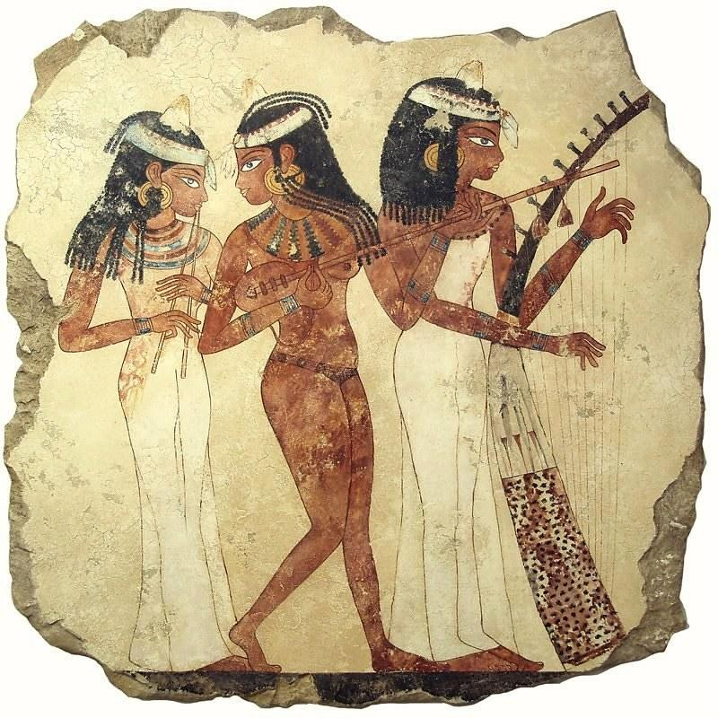
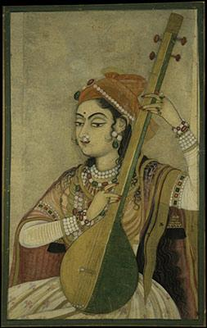
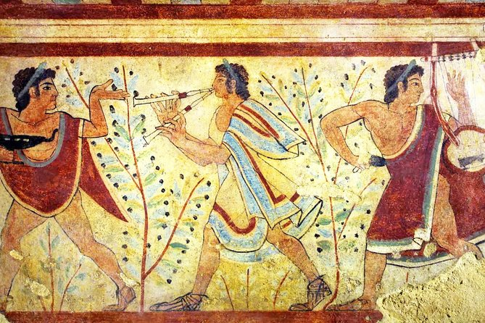
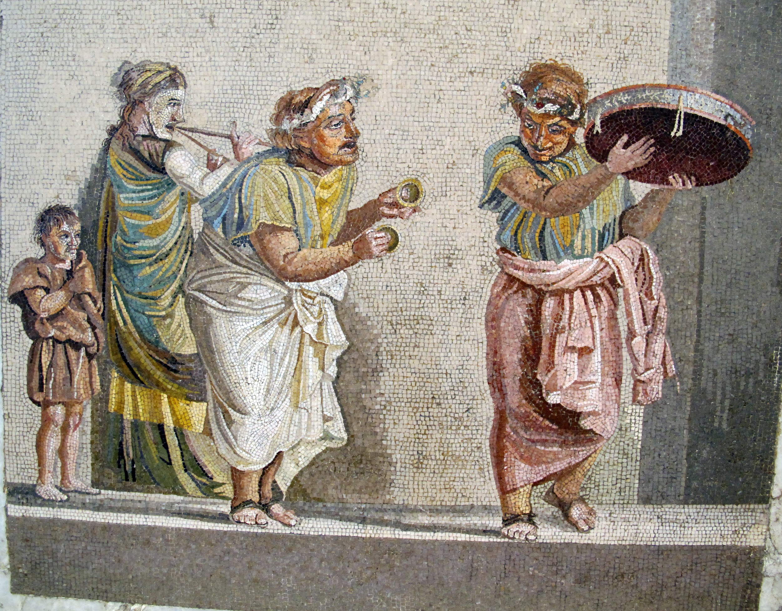

Slide 3
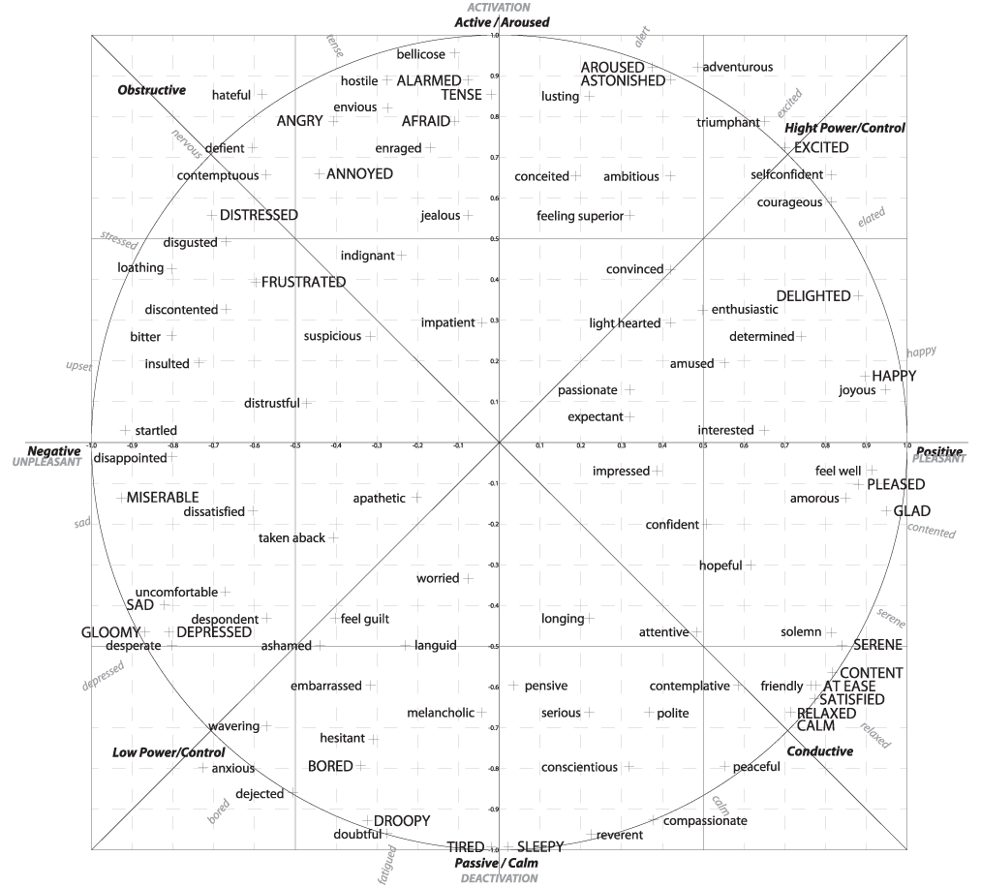
Valence VS Arousal

Slide 4
What mode of music do people mostly attracted to in 2017 , 2018 , 2019 ?!

Slide 5
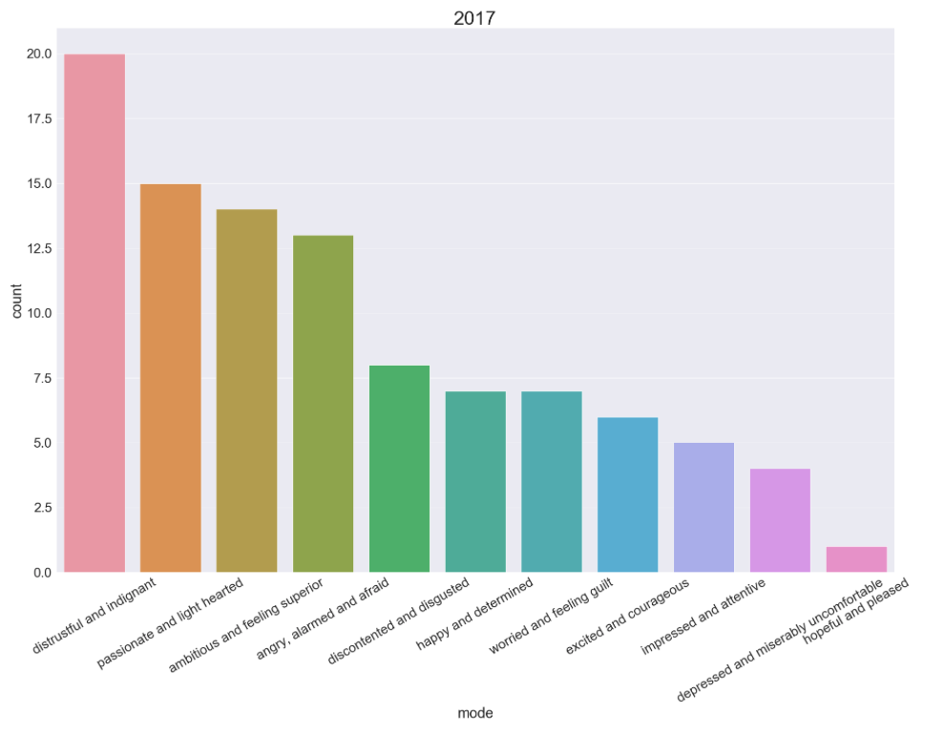
2017
Bad Things ‘Machine Gun Kelly’
Closer ‘The Chainsmokers’
Believer ‘Imagine Dragons’

Slide 6
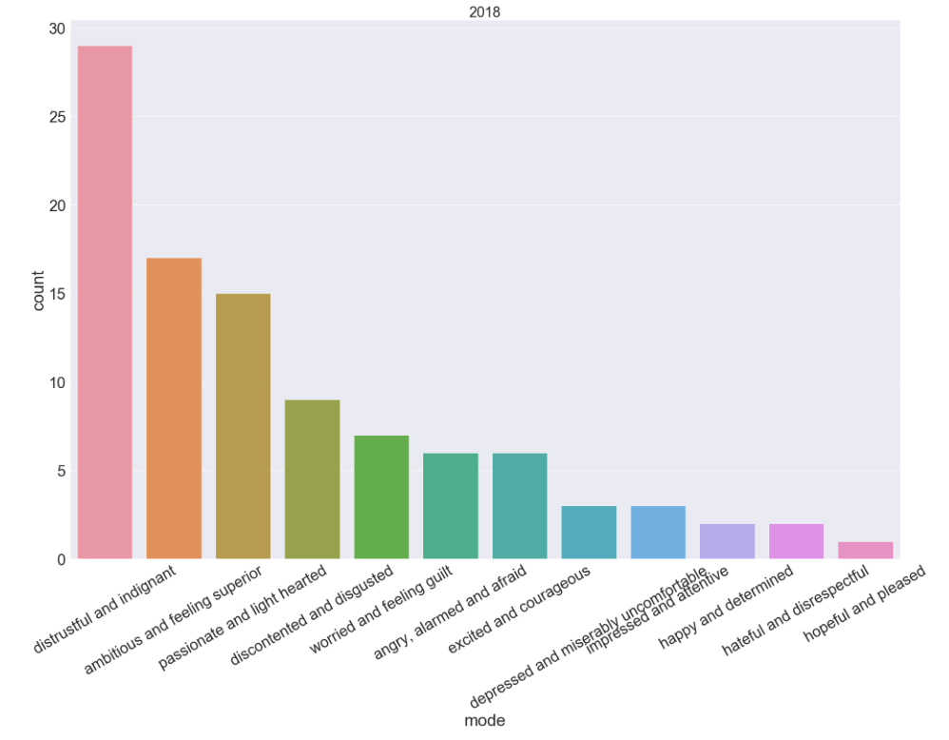
2018
SAD! ‘XXXTENTACION’
FRIENDS ‘Marshmello’
Moonlight ‘XXXTENTACION’

Slide 7
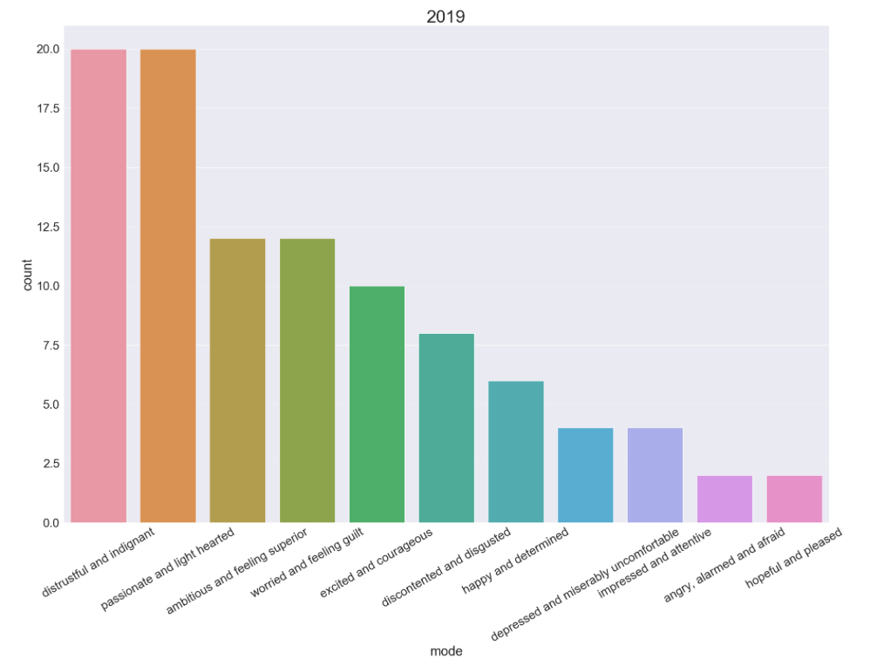
2019
How Do You Sleep? ‘Sam Smith’
Dance Monkey ‘Tones and I’
Con Calma ‘Daddy Yankee’

Slide 8
{::Differences::}

Slide 9
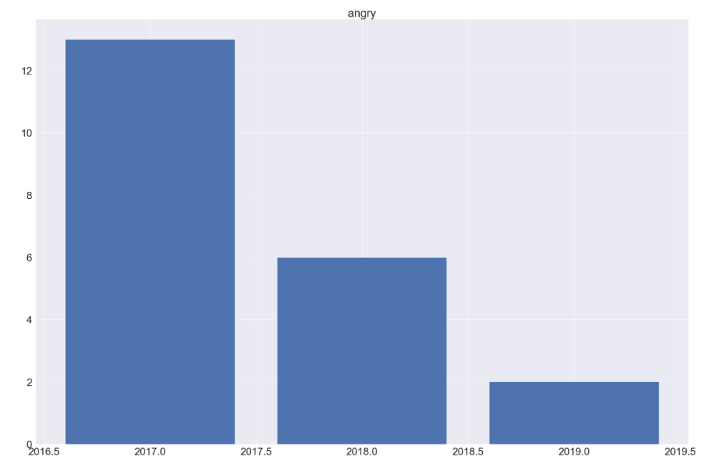
ANGER

Slide 10
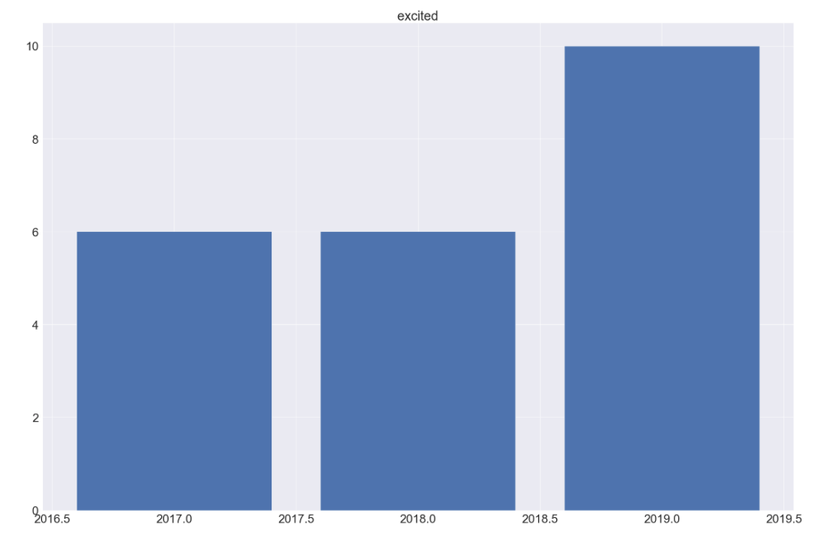
EXCITEMENT

Slide 11
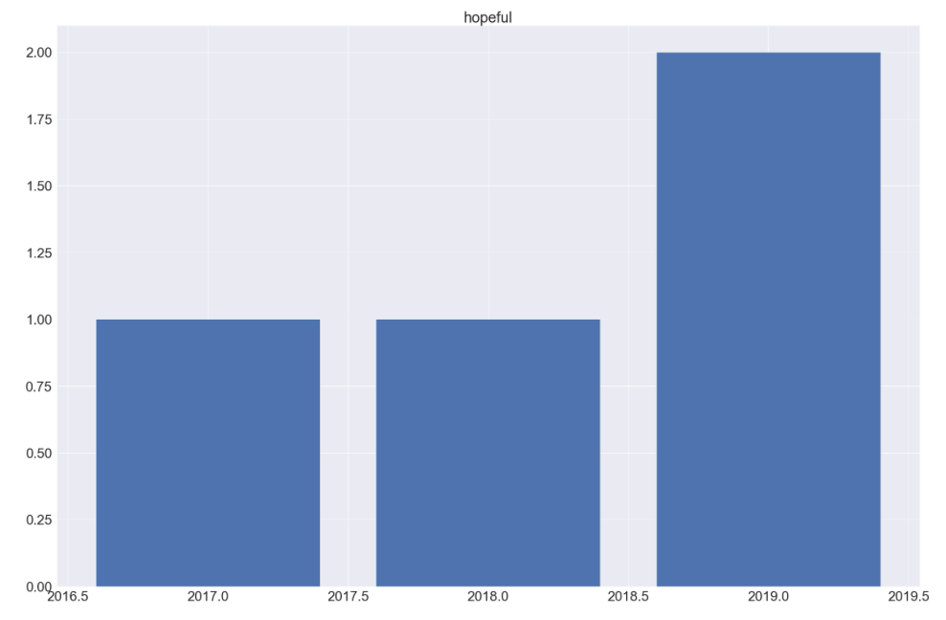
HOPE

Slide 12
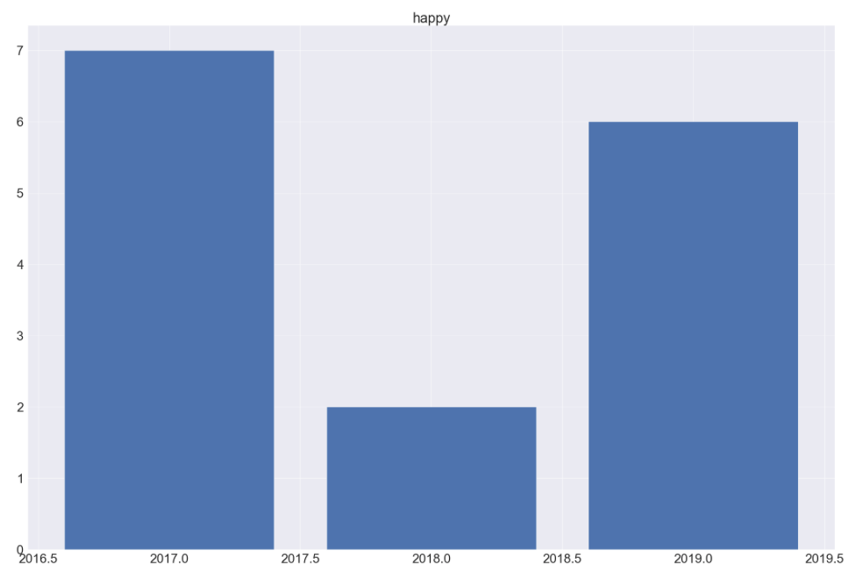
HAPPINESS

Slide 13
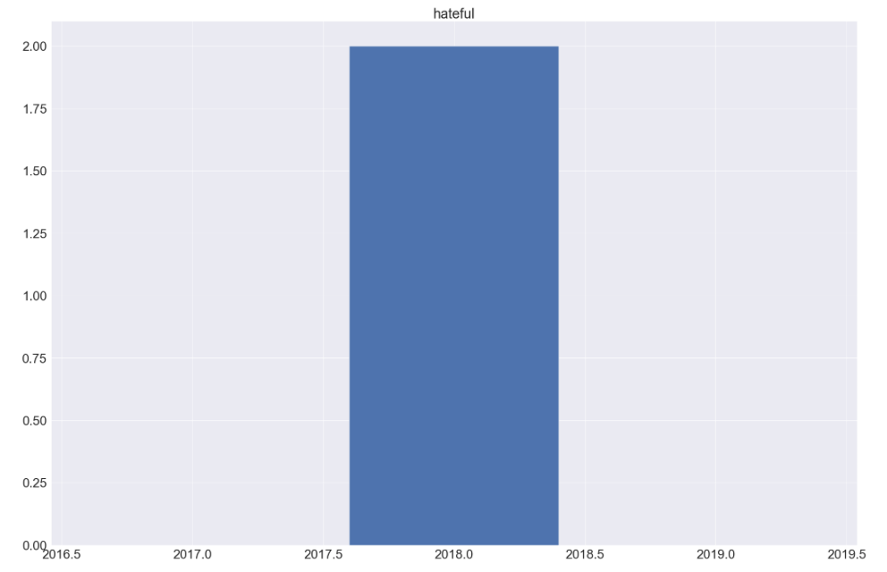
HATEFUL

Slide 14
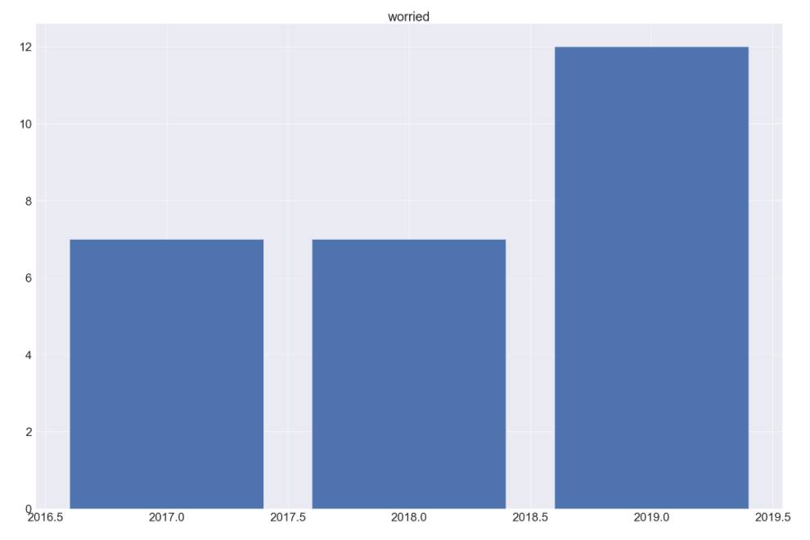
WORRY

Slide 15
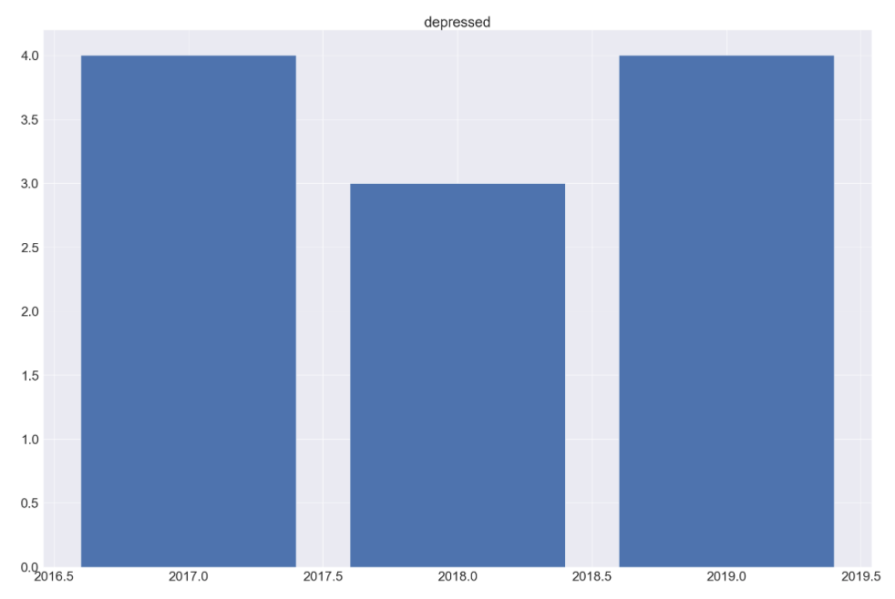
DEPRESSION

Slide 16
Do we match music or it matches us?

Slide 17
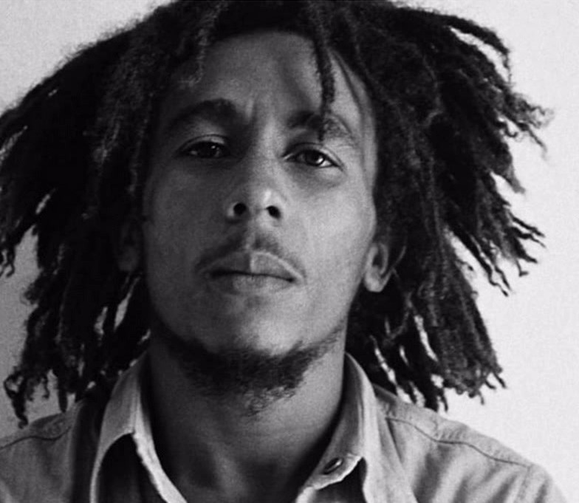
‘’’’ ONE GOOD THING ABOUT MUSIC WHEN IT HITS YOU, YOU FEEL NO PAIN’’’’
“” BOB MARLEY’’

Slide 18
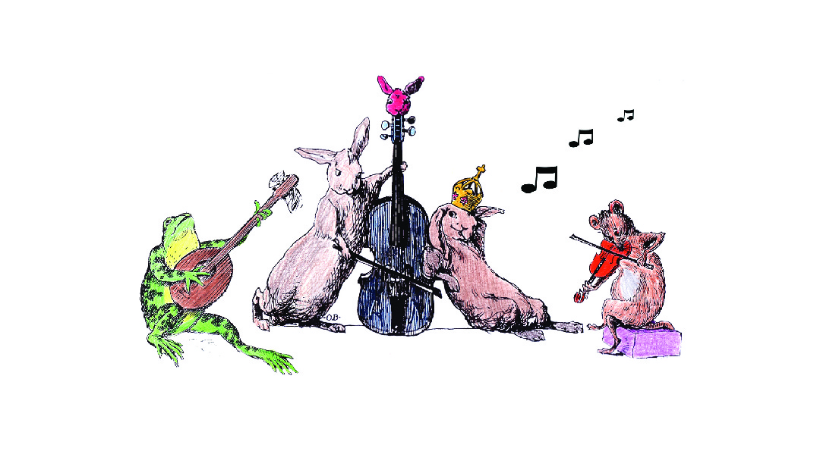
Any Questions ?!
Any questions?!

